Slide 1
DATA MINING
DR. Oluwatosin Oluwadare, 2023
Department of Computer Science , University of Colorado, Colorado springs.
CS 4434/5434 and dase 4435
Data Mining,
FALL 2023
Lecture 3: Know Your Data
Slides Adapted from Jiawei Han et al. and Jianlin Cheng

Slide 2
Data Mining: Concepts and Techniques — Chapter 2 —
Jiawei Han, Micheline Kamber, and Jian Pei
University of Illinois at Urbana-Champaign
Simon Fraser University
©2011 Han, Kamber, and Pei. All rights reserved.

Slide 3
Chapter 2: Getting to Know Your Data
Data Objects and Attribute Types
Basic Statistical Descriptions of Data
Data Visualization
Measuring Data Similarity and Dissimilarity
Summary

Slide 4
Types of Data Sets
Record
Relational records
Data matrix, e.g., numerical matrix, crosstabs
Document data: text documents: term-frequency vector
Transaction data
Graph and network
World Wide Web
Social or information networks
Molecular Structures
Ordered
Video data: sequence of images
Temporal data: time-series
Sequential Data: transaction sequences
Genetic sequence data
Spatial, image and multimedia:
Spatial data: maps
Image data:
Video data:

Slide 5
Important Characteristics of Structured Data
Dimensionality
Curse of dimensionality
Sparsity
Only presence counts
Resolution
Patterns depend on the scale
Distribution
Centrality and dispersion

Slide 6
Data Objects
Data sets are made up of data objects.
A data object represents an entity.
Examples:
sales database: customers, store items, sales
medical database: patients, treatments
university database: students, professors, courses
Also called samples , examples, instances, data points, objects, tuples.
Data objects are described by attributes.
Database rows -> data objects; columns ->attributes.

Slide 7
Attributes
Attribute (or dimensions, features, variables): a data field, representing a characteristic or feature of a data object.
E.g., customer _ID, name, address
Types:
Nominal
Binary
Numeric: quantitative
Interval-scaled
Ratio-scaled

Slide 8
Data Attributes
Attribute refers to the characteristic of the data object.
The nouns defining the characteristics are used interchangeably: Attribute, dimension, feature, and variable.
Field
Data Warehousing
Database and Data Mining
Statistic
Machine Learning
Characteristic term Used
Feature
Attribute
Variable
Dimension

Slide 9
Attribute Types
Nominal: categories, states, or “names of things”
Hair_color = {auburn, black, blond, brown, grey, red, white}
marital status, occupation, ID numbers, zip codes
Binary
Nominal attribute with only 2 states (0 and 1)
Symmetric binary: both outcomes equally important
e.g., cat or dog
Asymmetric binary: outcomes not equally important.
e.g., medical test (positive vs. negative)
Convention: assign 1 to most important outcome (e.g., HIV positive)
the positive (1) and negative (0) outcomes of a disease test.
Ordinal
Values have a meaningful order (ranking) but magnitude between successive values is not known.
Size = {small, medium, large}, grades, army rankings

Slide 10
Numeric Attribute Types
Quantity (integer or real-valued)
Interval
Measured on a scale of equal-sized units
Values have order
E.g., temperature in C˚or F˚, calendar dates
No true zero-point
Ratio
Inherent zero-point
We can speak of values as being an order of magnitude larger than the unit of measurement (10 K˚ is twice as high as 5 K˚).
e.g., temperature in Kelvin, length, counts, monetary quantities

Slide 11
Discrete vs. Continuous Attributes
Discrete Attribute
Has only a finite or countably infinite set of values
E.g., zip codes, profession, or the set of words in a collection of documents
Sometimes, represented as integer variables
Note: Binary attributes are a special case of discrete attributes
Continuous Attribute
Has real numbers as attribute values
E.g., temperature, height, or weight
Practically, real values can only be measured and represented using a finite number of digits
Continuous attributes are typically represented as floating-point variables

Slide 12
Chapter 2: Getting to Know Your Data
Data Objects and Attribute Types
Basic Statistical Descriptions of Data
Data Visualization
Measuring Data Similarity and Dissimilarity
Summary

Slide 13
Basic Statistical Descriptions of Data
Motivation
To better understand the data: central tendency, variation and spread
Data dispersion characteristics
median, max, min, quantiles, outliers, variance, etc.
Numerical dimensions correspond to sorted intervals
Data dispersion: analyzed with multiple granularities of precision
Boxplot or quantile analysis on sorted intervals
Dispersion analysis on computed measures
Folding measures into numerical dimensions
Boxplot or quantile analysis on the transformed cube

Slide 14
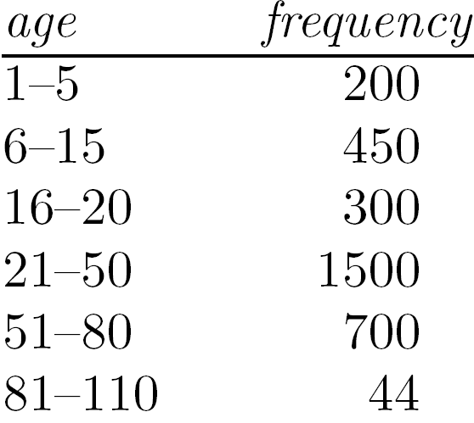
Measuring the Central Tendency
Mean (algebraic measure) (sample vs. population):
Note: n is sample size and N is population size.
Weighted arithmetic mean:
Trimmed mean: chopping extreme values
Median:
Middle value if odd number of values, or average of the middle two values otherwise
Estimated by interpolation (for grouped data):
Mode
Value that occurs most frequently in the data
Unimodal, bimodal, trimodal
Empirical formula:

Slide 15
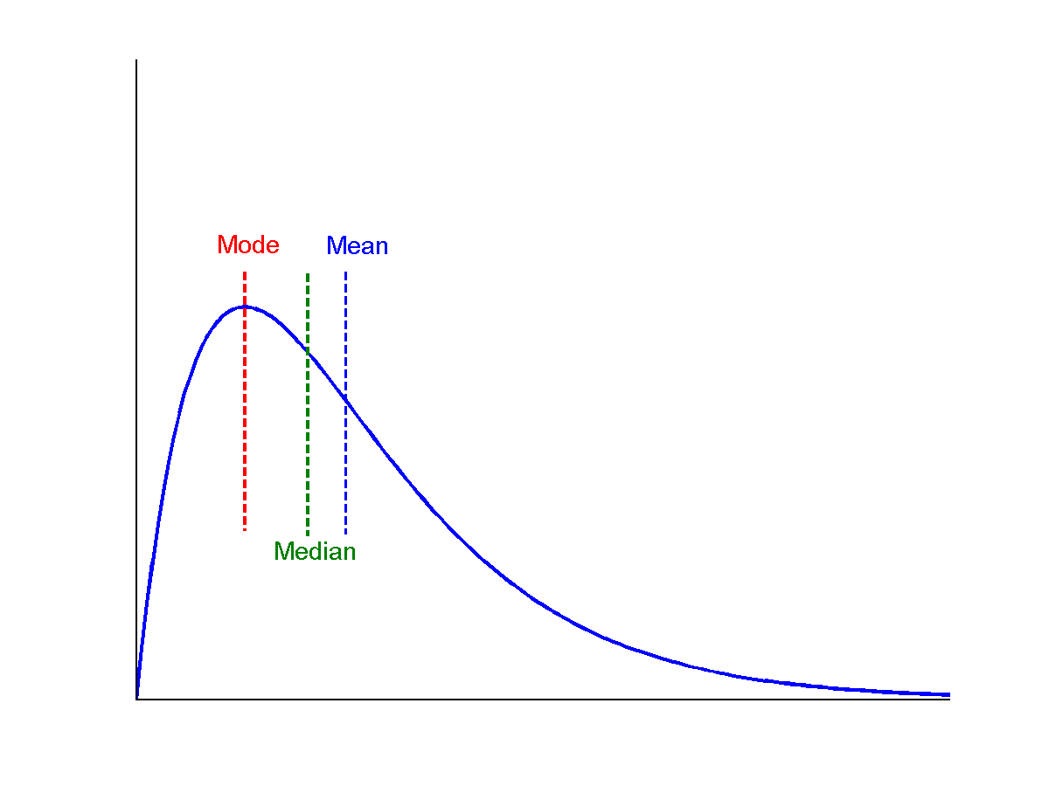
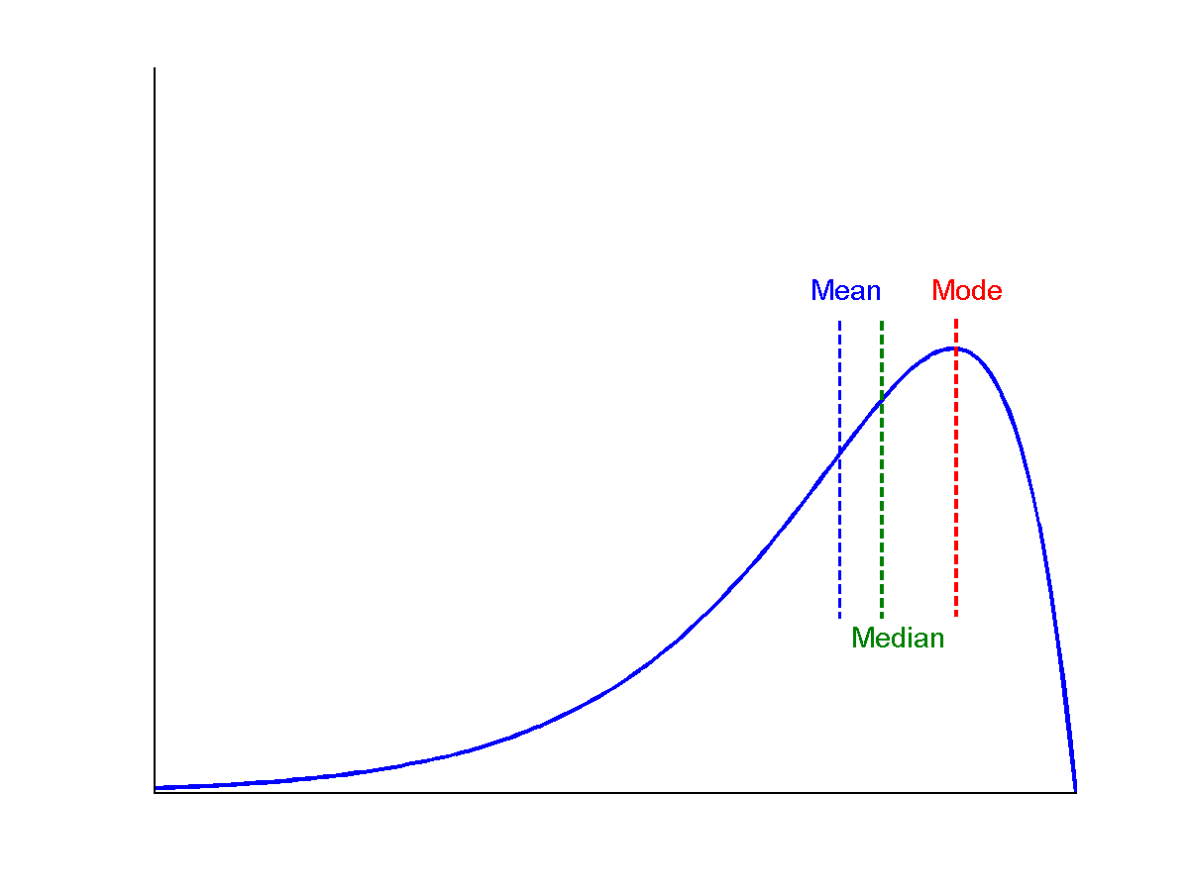
Symmetric vs. Skewed Data
Median, mean and mode of symmetric, positively and negatively skewed data
symmetric
positively skewed
negatively skewed

Slide 16
Measuring the Dispersion of Data
Quartiles, outliers and boxplots
Quartiles: Q₁ (25th percentile), Q₃ (75th percentile)
Inter-quartile range: IQR = Q₃ – Q₁
Five number summary: min, Q₁, median, Q₃, max
Boxplot: ends of the box are the quartiles; median is marked; add whiskers, and plot outliers individually
Outlier: usually, a value higher/lower than Q₃ + 1.5 x IQR or Q₁ – 1.5 x IQR
Variance and standard deviation (sample: s, population: σ)
Variance: (algebraic, scalable computation)
Standard deviation s (or σ) is the square root of variance s² ⁽or σ²⁾

Slide 17
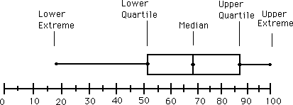
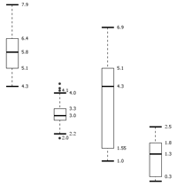
Boxplot Analysis
Five-number summary of a distribution
Minimum, Q1, Median, Q3, Maximum
Boxplot
Data is represented with a box
The ends of the box are at the first and third quartiles, i.e., the height of the box is IQR
The median is marked by a line within the box
Whiskers: two lines outside the box extended to Minimum and Maximum
Outliers: points beyond a specified outlier threshold, plotted individually

Slide 18
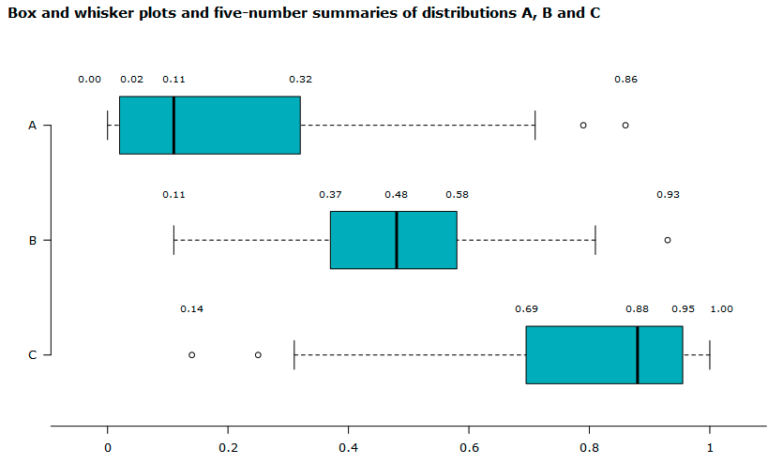
Boxplot Analysis Example
Distribution A is positively skewed, because the whisker and half-box are longer on the right side of the median than on the left side.
Distribution B is approximately symmetric, because both half-boxes are almost the same length (0.11 on the left side and 0.10 on the right side).
Distribution C is negatively skewed because the whisker and half-box are longer on the left side of the median than on the right side.
https://www150.statcan.gc.ca/n1/edu/power-pouvoir/ch12/5214889-eng.htm
Notes:
The centre of distribution A is the lowest of the three distributions (median is 0.11). The distribution is positively skewed, because the whisker and half-box are longer on the right side of the median than on the left side.
Distribution B is approximately symmetric, because both half-boxes are almost the same length (0.11 on the left side and 0.10 on the right side). It’s the most concentrated distribution because the interquartile range is 0.21, compared to 0.30 for distribution A and 0.26 for distribution C.
The centre of distribution C is the highest of the three distributions (median is 0.88). The distribution C is negatively skewed because the whisker and half-box are longer on the left side of the median than on the right side.

Slide 19
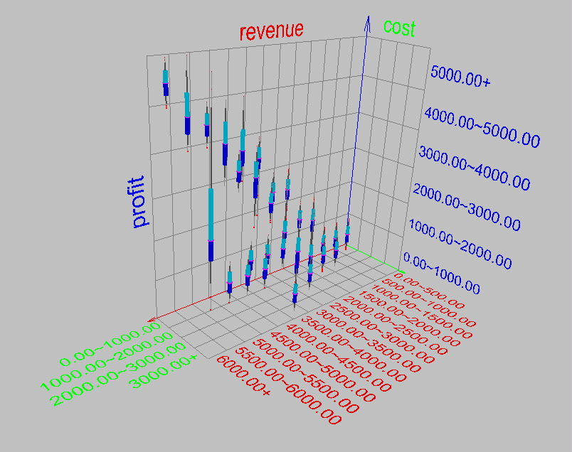
Visualization of Data Dispersion: 3-D Boxplots

Slide 20
Properties of Normal Distribution Curve
The normal (distribution) curve
From μ–σ to μ+σ: contains about 68% of the measurements (μ: mean, σ: standard deviation)
From μ–2σ to μ+2σ: contains about 95% of it
From μ–3σ to μ+3σ: contains about 99.7% of it

Slide 21
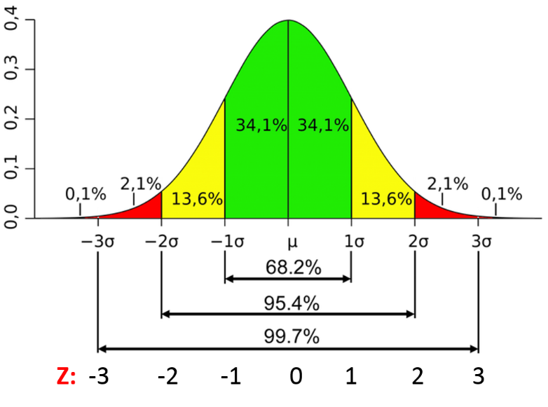
Standard deviation in a Normal Distribution
Images/google

Slide 22
Graphic Displays of Basic Statistical Descriptions
Boxplot: graphic display of five-number summary
Histogram: x-axis are values, y-axis repres. frequencies
Quantile plot: each value x_{i} is paired with f_{i} indicating that approximately 100 f_{i} % of data are ≤ x_{i}
Quantile-quantile (q-q) plot: graphs the quantiles of one univariant distribution against the corresponding quantiles of another
Scatter plot: each pair of values is a pair of coordinates and plotted as points in the plane

Slide 23
Histogram Analysis
Histogram: Graph display of tabulated frequencies, shown as bars
It shows what proportion of cases fall into each of several categories
Differs from a bar chart in that it is the area of the bar that denotes the value, not the height as in bar charts, a crucial distinction when the categories are not of uniform width
The categories are usually specified as non-overlapping intervals of some variable. The categories (bars) must be adjacent

Slide 24
Homework 1
Homework 1 has been posted at the course web site and on Canvas.
Due Sept. 12, 2023
Submit it to Canvas

Slide 25
Histograms Often Tell More than Boxplots
The two histograms shown in the left may have the same boxplot representation
The same values for: min, Q1, median, Q3, max
But they have rather different data distributions

Slide 26
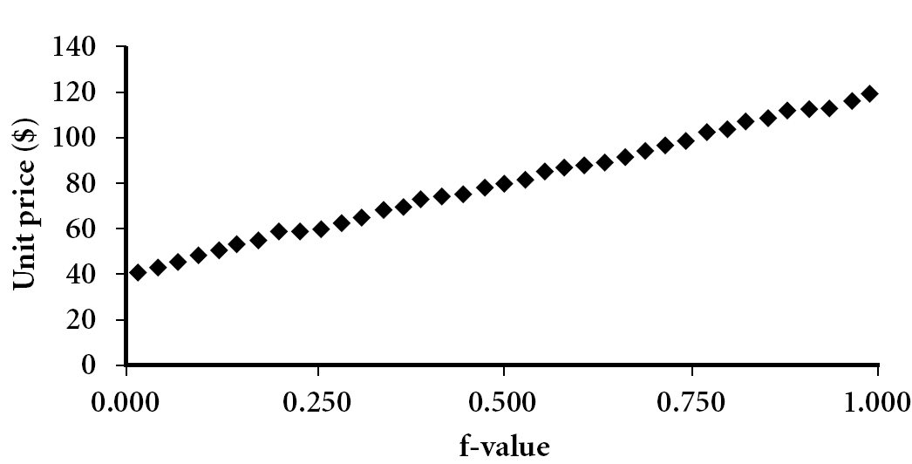
Quantile Plot
Displays all of the data (allowing the user to assess both the overall behavior and unusual occurrences)
Plots quantile information
For a data x_{i} data sorted in increasing order, f_{i} indicates that approximately 100 f_{i}% of the data are below or equal to the value x_{i}

Slide 27
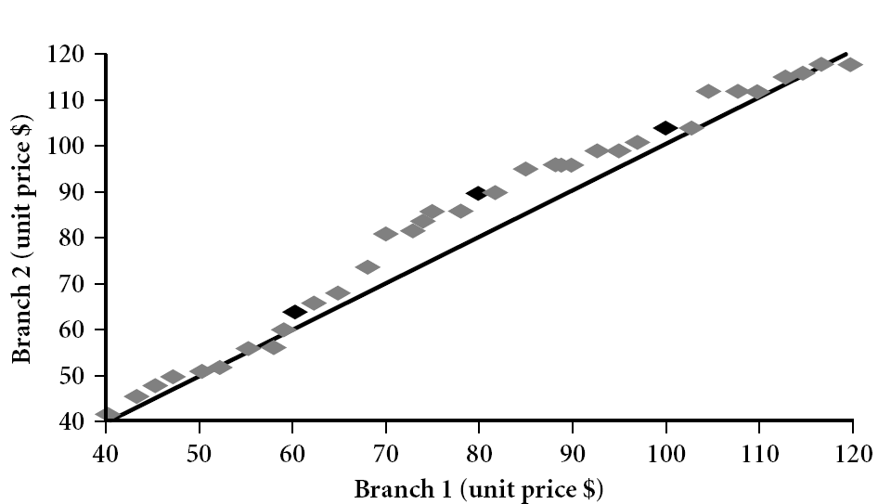
Quantile-Quantile (Q-Q) Plot
Graphs the quantiles of one univariate distribution against the corresponding quantiles of another
View: Is there is a shift in going from one distribution to another?
Example shows unit price of items sold at Branch 1 vs. Branch 2 for each quantile. Unit prices of items sold at Branch 1 tend to be lower than those at Branch 2.
Notes:
Note: We need to label the dark plotted points as Q1, Median, Q3 – that would help in understanding this graph.
Tell audience: There is a shift in distribution of branch 1 WRT branch 2 in that the unit prices of items sold at branch 1 tend to be lower than those at branch 2.

Slide 28
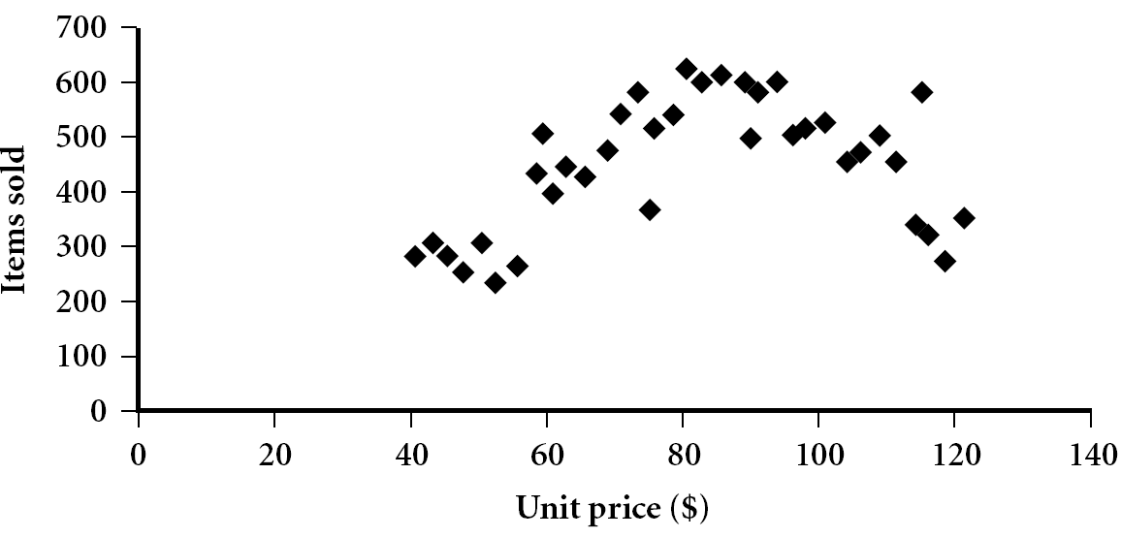
Scatter plot
Provides a first look at bivariate data to see clusters of points, outliers, etc
Each pair of values is treated as a pair of coordinates and plotted as points in the plane

Slide 29
Positively and Negatively Correlated Data
The left half fragment is positively correlated
The right half is negative correlated

Slide 30
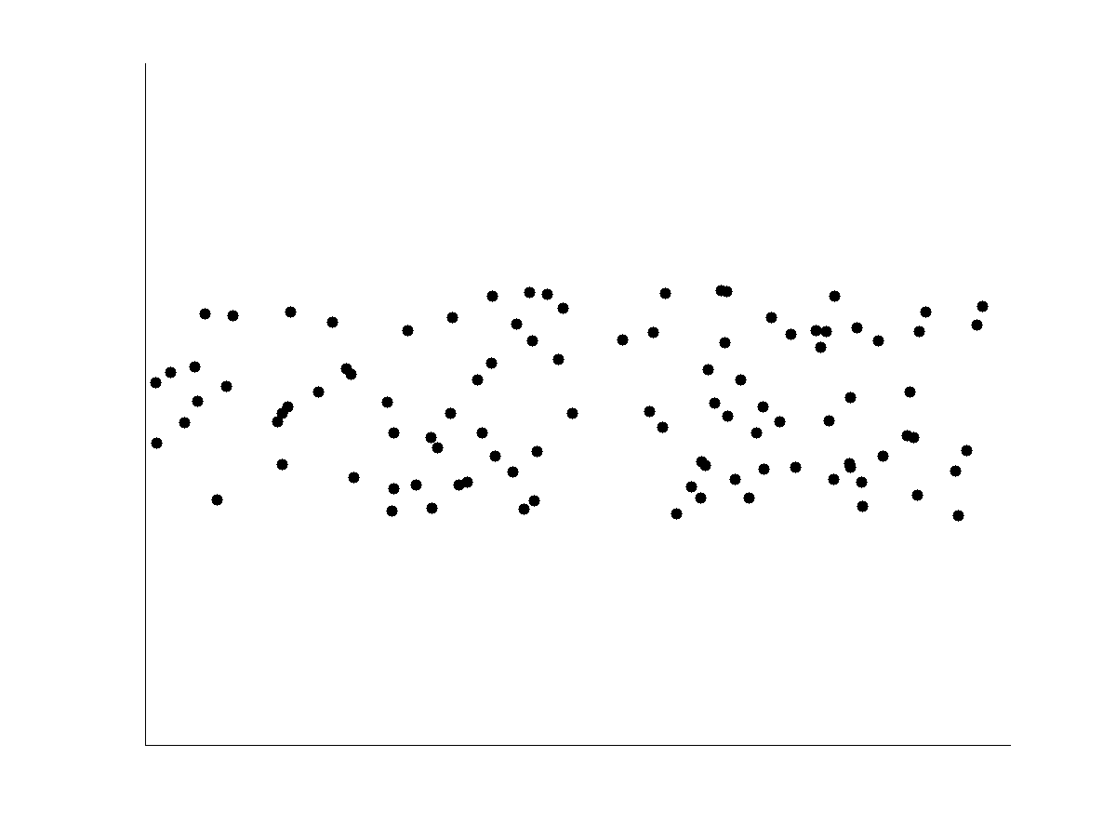
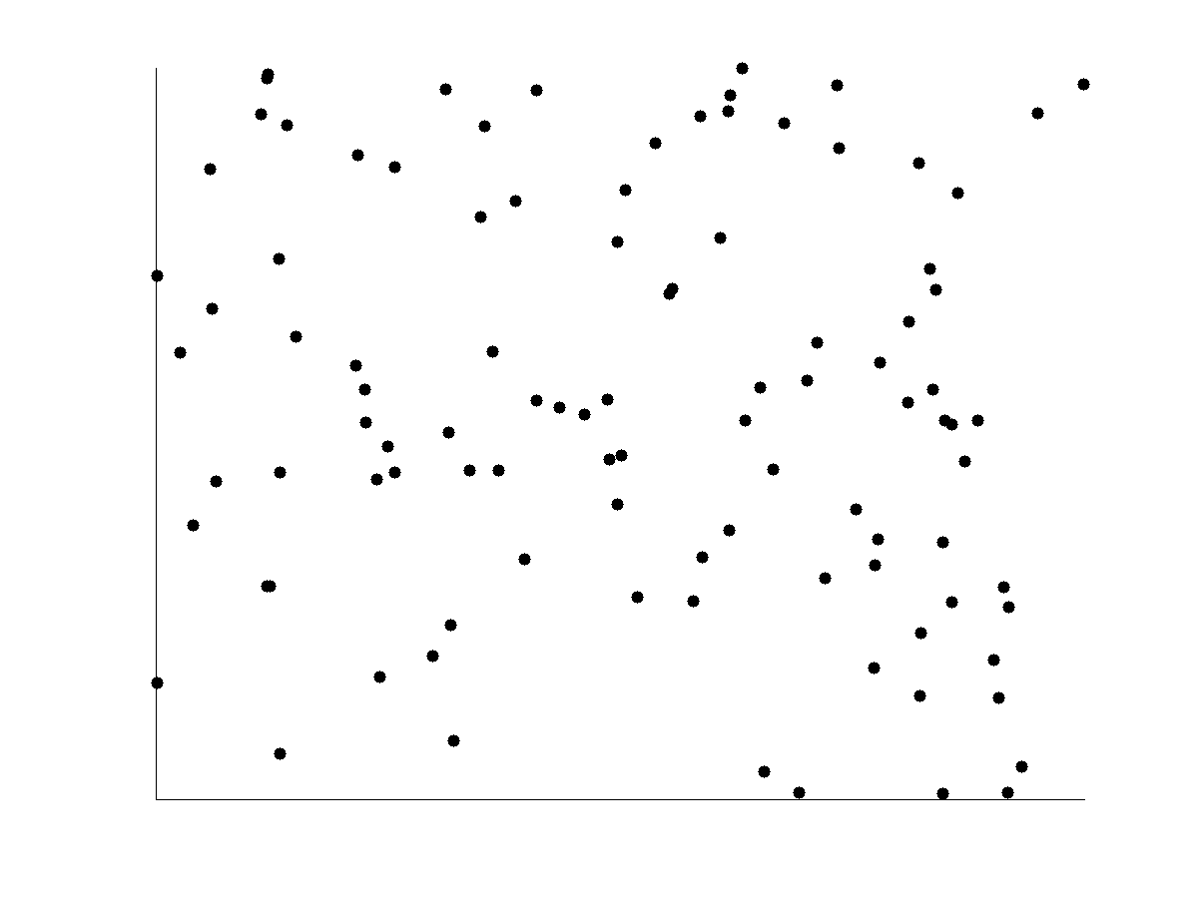
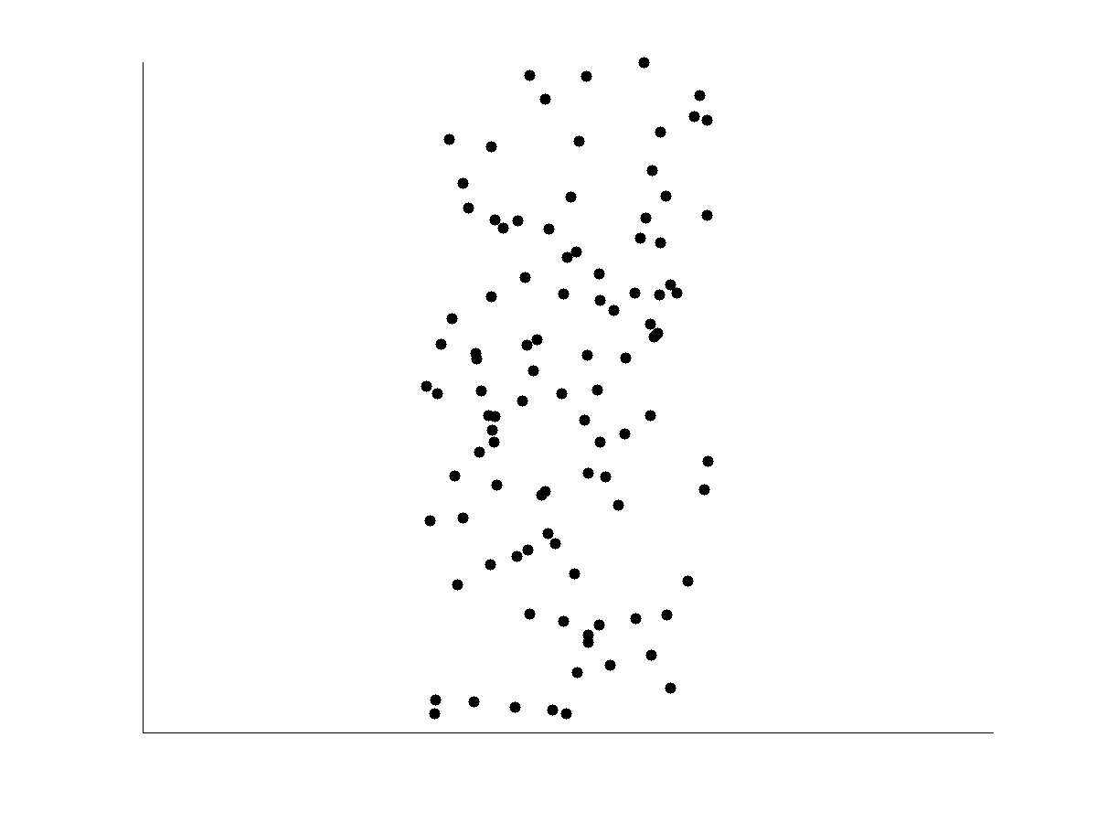
Uncorrelated Data

Slide 31
Chapter 2: Getting to Know Your Data
Data Objects and Attribute Types
Basic Statistical Descriptions of Data
Data Visualization
Measuring Data Similarity and Dissimilarity
Summary

Slide 32
Similarity and Dissimilarity
Similarity
Numerical measure of how alike two data objects are
Value is higher when objects are more alike
Often falls in the range [0,1]
Dissimilarity (e.g., distance)
Numerical measure of how different two data objects are
Lower when objects are more alike
Minimum dissimilarity is often 0
Upper limit varies
Proximity refers to a similarity or dissimilarity

Slide 33
Data Matrix and Dissimilarity Matrix
Data matrix
n data points with p dimensions
Two modes
Dissimilarity matrix
n data points, but registers only the distance
A triangular matrix
Single mode

Slide 34
Proximity Measure for Nominal Attributes
Can take 2 or more states, e.g., red, yellow, blue, green (generalization of a binary attribute)
Method 1: Simple matching
m: # of matches, p: total # of variables
Method 2: Use a large number of binary attributes
creating a new binary attribute for each of the M nominal states

Slide 35
Class Example: Method 1

Slide 36
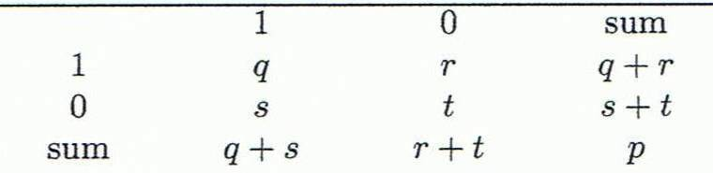
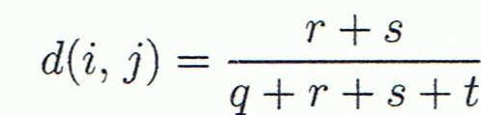
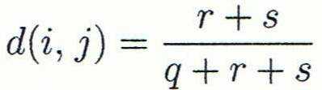

Proximity Measure for Binary Attributes
Object j
A contingency table for binary data
Distance measure for symmetric binary variables:
Distance measure for asymmetric binary variables:
Jaccard coefficient (similarity measure for asymmetric binary variables):
Object i
Note: Jaccard coefficient is the same as “coherence”:

Slide 37
Variables (q, r, s ,t)
q is the number of attributes that equal 1 for both objects i and j,
r is the number of attributes that equal 1 for object i but equal 0 for object j,
s is the number of attributes that equal 0 for object i but equal 1 for object j, and
t is the number of attributes that equal 0 for both objects i and j.

Slide 38
Dissimilarity between Binary Variables
Example
Gender is a symmetric attribute
The remaining attributes are asymmetric binary attributes
Let the values Y(yes) and P(positive) be 1, and the value N(no and negative) 0

Slide 39
Calculate the Dissimilarity
d(Jack, Mary) = ?
d(Jack, Jim). = ?
d(Jim, Jack) = ?
q is the number of attributes that equal 1 for both objects i and j,
r is the number of attributes that equal 1 for object i but equal 0 for object j,
s is the number of attributes that equal 0 for object i but equal 1 for object j, and
t is the number of attributes that equal 0 for both objects i and j.
OR

Slide 40
Dissimilarity between Binary Variables
Example
Gender is a symmetric attribute
The remaining attributes are asymmetric binary attributes
Let the values Y(yes) and P(positive) be 1, and the value N(no and negative) 0

Slide 41
Comment on the Result
What does the measurement suggest?
These measurements suggest that Jim and Mary are unlikely to have a similar disease because they have the highest dissimilarity value among the three pairs.
Of the three patients, Jack and Mary are the most likely to have a similar disease.

Slide 42
Standardizing Numeric Data
Z-score:
X: raw score to be standardized, μ: mean of the population, σ: standard deviation
the distance between the raw score and the population mean in units of the standard deviation
negative when the raw score is below the mean, “+” when above
An alternative way: Calculate the mean absolute deviation
where
standardized measure (z-score):
Using mean absolute deviation is more robust than using standard deviation

Slide 43
Example: Data Matrix and Dissimilarity Matrix
Data Matrix
Dissimilarity Matrix
(with Euclidean Distance)

Slide 44
Distance on Numeric Data: Minkowski Distance
Minkowski distance: A popular distance measure
where i = (x_{i1}, x_{i2}, …, x_{ip}) and j = (x_{j1}, x_{j2}, …, x_{jp}) are two p-dimensional data objects, and h is the order (the distance so defined is also called L-h norm)
Properties
d(i, j) > 0 if i ≠ j, and d(i, i) = 0 (Positive definiteness)
d(i, j) = d(j, i) (Symmetry)
d(i, j) ≤ d(i, k) + d(k, j) (Triangle Inequality)
A distance that satisfies these properties is a metric

Slide 45
Special Cases of Minkowski Distance
h = 1: Manhattan (city block, L₁ norm) distance
E.g., the Hamming distance: the number of bits that are different between two binary vectors
h = 2: (L₂ norm) Euclidean distance
h → ∞. “supremum” (L_{max} norm, L∞ norm) distance.
This is the maximum difference between any component (attribute) of the vectors

Slide 46
Example: Minkowski Distance
Dissimilarity Matrices
Manhattan (L₁)
Euclidean (L₂)
Supremum

Slide 47
Ordinal Variables
An ordinal variable can be discrete or continuous
Order is important, e.g., rank
Can be treated like interval-scaled
replace x_{if} by their rank
map the range of each variable onto [0, 1] by replacing i-th object in the f-th variable by
compute the dissimilarity using methods for interval-scaled variables

Slide 48
Attributes of Mixed Type
A database may contain all attribute types
Nominal, symmetric binary, asymmetric binary, numeric, ordinal
One may use a weighted formula to combine their effects
f is binary or nominal:
d_{ij}^{(f)} = 0 if x_{if} = x_{jf} , or d_{ij}^{(f)} = 1 otherwise
f is numeric: use the normalized distance
f is ordinal
Compute ranks r_{if} and
Treat z_{if} as interval-scaled

Slide 49
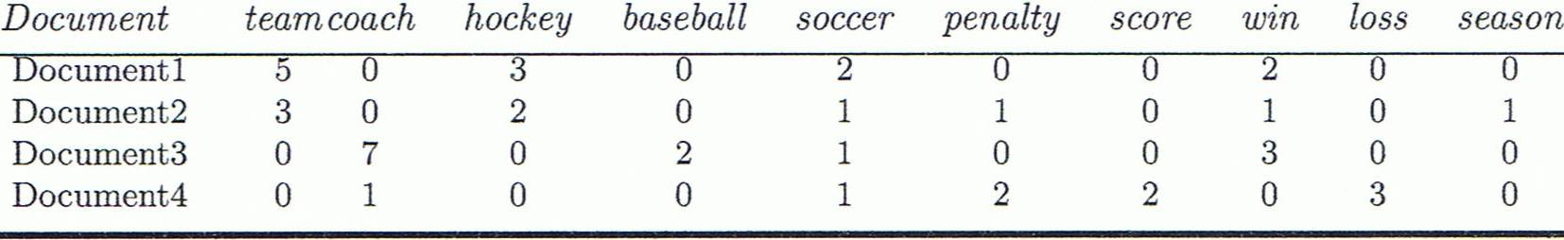
Cosine Similarity
A document can be represented by thousands of attributes, each recording the frequency of a particular word (such as keywords) or phrase in the document.
Other vector objects: gene features in micro-arrays, …
Applications: information retrieval, biologic taxonomy, gene feature mapping, ...
Cosine measure: If d₁ and d₂ are two vectors (e.g., term-frequency vectors), then
cos(d₁, d₂) = (d₁ • d₂) /||d₁|| ||d₂|| ,
where • indicates vector dot product, ||d||: the length of vector d

Slide 50
Example: Cosine Similarity
cos(d₁, d₂) = (d₁ • d₂) /||d₁|| ||d₂|| ,
where • indicates vector dot product, ||d|: the length of vector d
Ex: Find the similarity between documents 1 and 2.
d₁ = (5, 0, 3, 0, 2, 0, 0, 2, 0, 0)
d₂ = (3, 0, 2, 0, 1, 1, 0, 1, 0, 1)
d₁•d₂ = 5*3+0*0+3*2+0*0+2*1+0*1+0*1+2*1+0*0+0*1 = 25
||d₁||= (5*5+0*0+3*3+0*0+2*2+0*0+0*0+2*2+0*0+0*0)^{0.5}=(42)^{0.5} = 6.481
||d₂||= (3*3+0*0+2*2+0*0+1*1+1*1+0*0+1*1+0*0+1*1)^{0.5}=(17)^{0.5} = 4.12
cos(d₁, d₂ ) = 0.94

Slide 51
Chapter 2: Getting to Know Your Data
Data Objects and Attribute Types
Basic Statistical Descriptions of Data
Data Visualization
Measuring Data Similarity and Dissimilarity
Summary

Slide 52
Summary
Data attribute types: nominal, binary, ordinal, interval-scaled, ratio-scaled
Many types of data sets, e.g., numerical, text, graph, Web, image.
Gain insight into the data by:
Basic statistical data description: central tendency, dispersion, graphical displays
Data visualization: map data onto graphical primitives
Measure data similarity
Above steps are the beginning of data preprocessing.
Many methods have been developed but still an active area of research.

Slide 53
References
W. Cleveland, Visualizing Data, Hobart Press, 1993
T. Dasu and T. Johnson. Exploratory Data Mining and Data Cleaning. John Wiley, 2003
U. Fayyad, G. Grinstein, and A. Wierse. Information Visualization in Data Mining and Knowledge Discovery, Morgan Kaufmann, 2001
L. Kaufman and P. J. Rousseeuw. Finding Groups in Data: an Introduction to Cluster Analysis. John Wiley & Sons, 1990.
H. V. Jagadish, et al., Special Issue on Data Reduction Techniques. Bulletin of the Tech. Committee on Data Eng., 20(4), Dec. 1997
D. A. Keim. Information visualization and visual data mining, IEEE trans. on Visualization and Computer Graphics, 8(1), 2002
D. Pyle. Data Preparation for Data Mining. Morgan Kaufmann, 1999
S. Santini and R. Jain,” Similarity measures”, IEEE Trans. on Pattern Analysis and Machine Intelligence, 21(9), 1999
E. R. Tufte. The Visual Display of Quantitative Information, 2nd ed., Graphics Press, 2001
C. Yu , et al., Visual data mining of multimedia data for social and behavioral studies, Information Visualization, 8(1), 2009

